Slide 1
The APEX Program Advancement through Pardons and Expungements

Slide 2
Introduction
Dominique Truitt
New Castle County Coordinator
302-761-8256 (Office)
302-333-7605 (Cell)
Dominique.Truitt@state.de.us
Andrew Duncan
Downstate Coordinator
Kent County: 302-233-6462
Sussex County: 302-333-7600
Andrew.Duncan@state.de.us

Slide 3
A free service for job seekers in Delaware:
1-on-1 Assistance
Access to High-Speed Internet
Workshops
Resume writing | Applying to jobs
Finding available jobs | Preparing for Interviews
Computer Skills | GED
Microsoft Office | ESL
Wilmington: 222-8507 Georgetown: 270-4829 Dover: 222-8509 Seaford: 222-3618

Slide 4
ABOUT APEX
APEX is dedicated to opening opportunities to individuals with criminal histories who wish to obtain gainful employment.
APEX is operated by the Division of Vocational Rehabilitation, in conjunction with the Division of Social Services.

Slide 5
Before We Get Started: Do You Qualify for our program?
A) You have never been convicted of an adult offense in Delaware.
OR
You have been convicted of an adult offense, but you have not been arrested, incarcerated, or on probation or parole in the past 3 years.
B) You have no pending or unresolved charges.
C) Your offenses are in the State of Delaware.
Notes:
Before we get started…

Slide 6
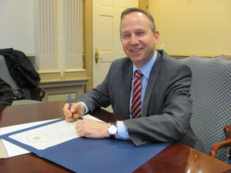
PARDONS

Slide 7
What is a PARDON?
Pardons
A PARDON is an official statement of forgiveness by the Governor.
The Governor issues an official, signed letter to the pardoned individual.
It indicates that the recipient is reformed, living a productive life, and no longer a threat to society.

Slide 8
What Does a PARDON Do?
Pardons
A PARDON can restore your civil rights, such as the rights to vote, hold public office, and own a firearm.
A PARDON changes your criminal record to indicate that your offenses have been pardoned.
A PARDON may be viewed favorably by employers and licensing agencies.

Slide 9
What a PARDON Does NOT Do
Pardons
A PARDON does not erase the offenses from your criminal record.

Slide 10
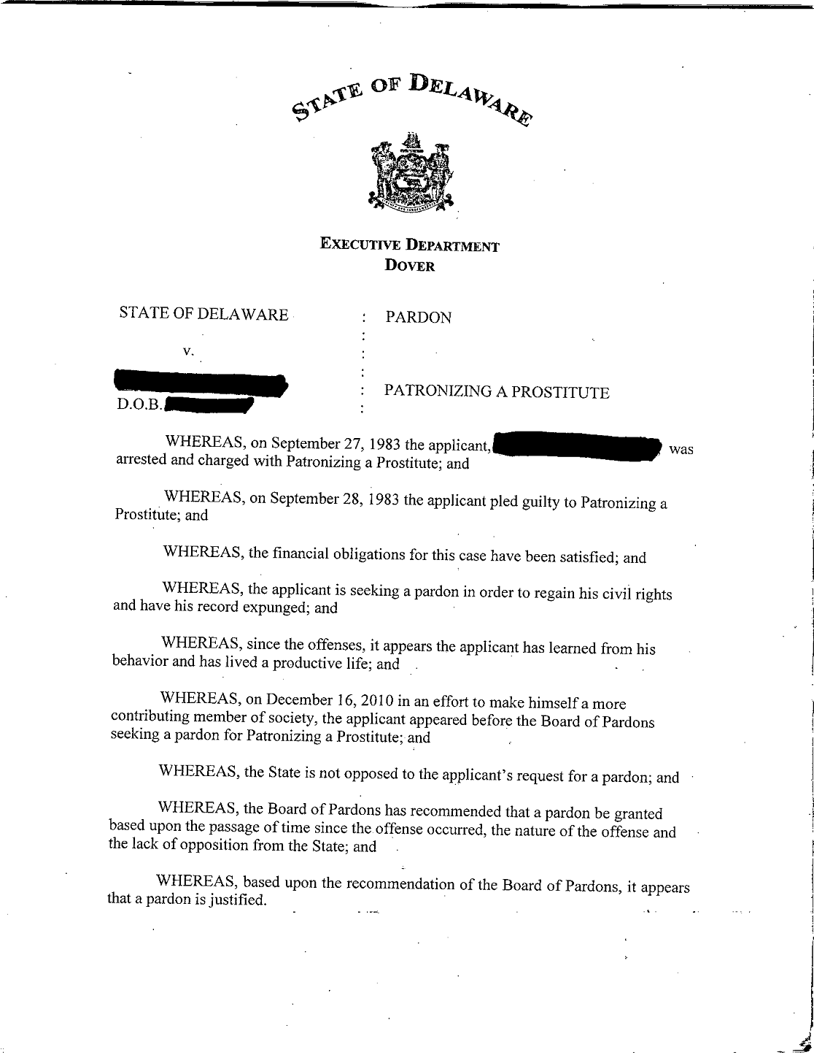

Slide 11
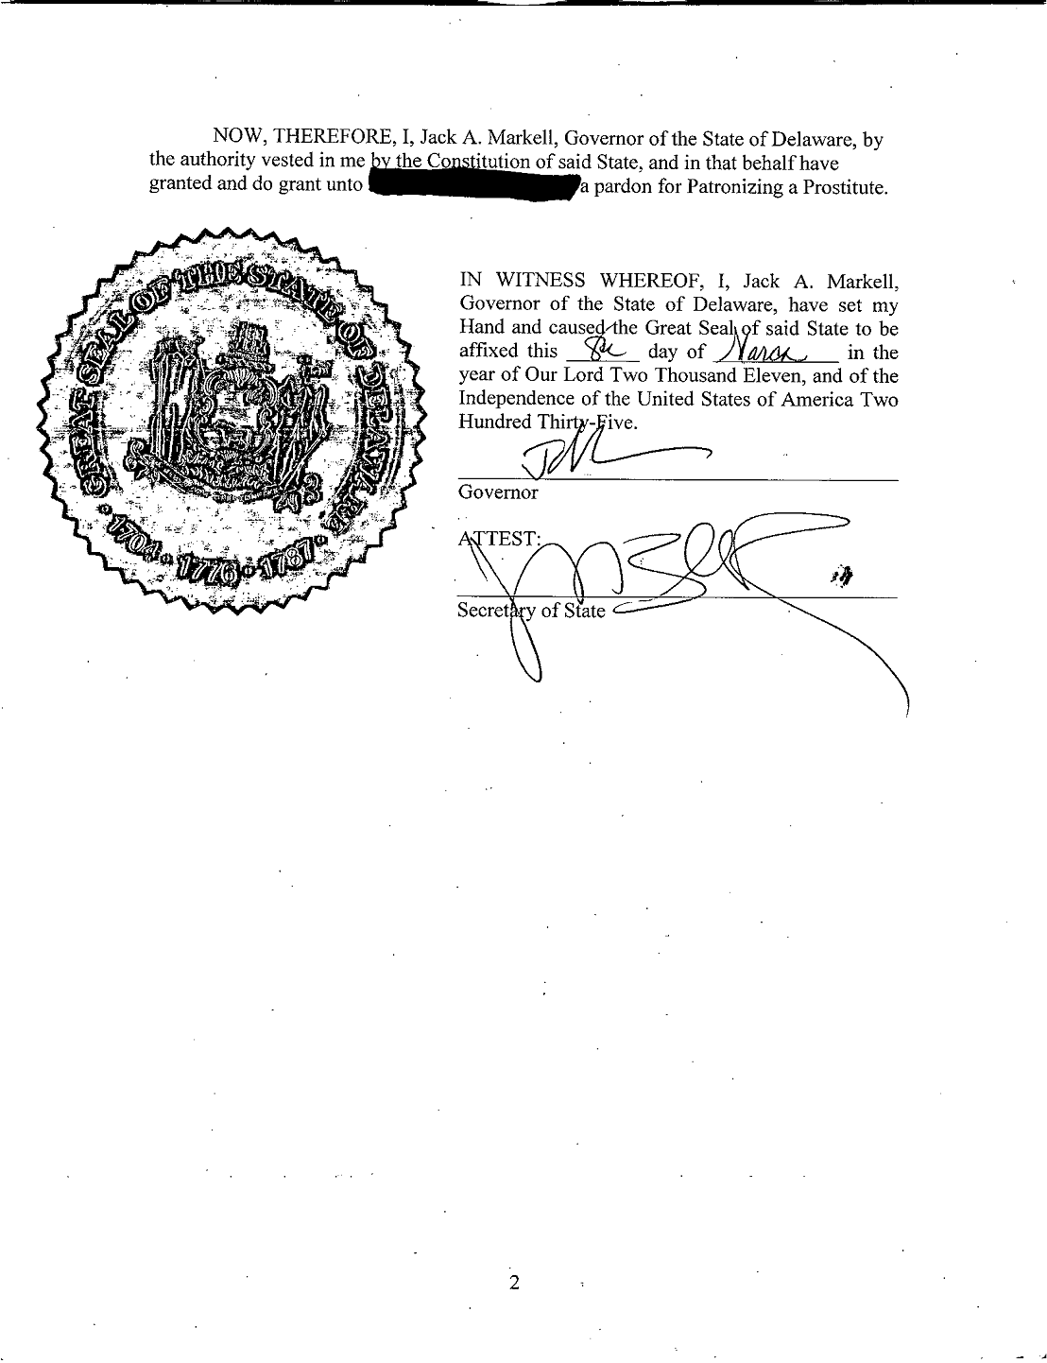

Slide 12
Who is ELIGIBLE for a PARDON?
Pardons
To be ELIGIBLE for a pardon:
Your convictions must be in the State of Delaware, and not federal or out-of-state.
You must have completed all phases of your sentence(s), including probation and parole.
You may not be delinquent on payment of any restitution, fees, or fines from your offenses.
You may not have any pending charges.

Slide 13
The CRITERIA
Pardons
You are more likely to receive a pardon if:
There has been a significant lapse of time since your most recent offense or arrest.
You accept responsibility – you acknowledge guilt, admit that you were wrong, & understand how you hurt others.
You demonstrate remorse – you show regret for your actions and are apologetic to those affected by your actions.
You have demonstrated good citizenship – volunteering, church involvement, supporting a family, employment, etc.
You have pursued self-improvement – getting an education, completing rehab, changing your people & places, etc.

Slide 14
The PROCEDURES
Pardons
The granting of a PARDON requires two actions:
The Board of Pardons must recommend your application to the Governor.
AND
The Governor must approve your pardon

Slide 15
Timeline
Pardons
The Board of Pardons meets monthly. However, once you submit your application, you will need to wait 3+ months to appear for a hearing.
If the Board recommends you for a pardon, the GOVERNOR will decide whether to grant your pardon about 3+ months later.
All in all, the whole process from beginning to end can take up to two years or less.

Slide 16
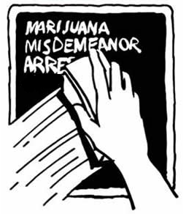
EXPUNGEMENTS

Slide 17
What is an Expungement?
Expungements
An EXPUNGEMENT seals a criminal record, so that it does not appear on state-run background checks.

Slide 18
Mandatory Expungement
Scenario #1:
All Charges Terminated in your Favor
Or
After 3 years for a single violation conviction
Or
After 5 years for a single misdemeanor conviction
*Exclusions Apply
Eligible Applicants must:
Complete fingerprints with the State Bureau of Identification(SBI)
Wait 4-6 weeks to receive Official Eligibility letter and SBI Report
Complete application and return form and filing fee to SBI’s Office directly.

Slide 19
Discretionary Expungement
Scenario #2:
• After 3 years for a single misdemeanor conviction for one or more charges relating to the same case for specified offenses
Or
• After 7 years for multiple a single misdemeanor convictions for one or more charges relating to the same case for specified offenses not included above
Or
• After 7 years for a single felony conviction
*Exclusions Apply
Eligible Applicants must:
Complete fingerprints with SBI to receive Eligibility letter and SBI Report
File petition and filing fee with applicable court(Family or Superior Court)
AG will send a response to the Court indicating its opposition or support
Presiding Judge will have the discretion to grant or deny the petition
A hearing will be scheduled only if Court deems necessary

Slide 20
Expungement After Pardon
Scenario #3
After receiving a Governor’s pardon
Eligible Applicants must:
Complete fingerprints with SBI to receive SBI Report
Submit pardon application with applicable documentation
Attend scheduled Board of Pardons Hearing at KC Courthouse
If recommended by the Board, applicant must await the Governor’s final decision
If Pardon is officially granted, begin discretionary expungement process

Slide 21
Juvenile Expungement
Scenario #4:
Eligibility depends on the number of juvenile charges, the severity of the offenses, & the time elapsed since the offenses.
Eligible Applicants Must:
Complete fingerprints with the State Bureau of Identification(SBI)
Wait 4-6 weeks to receive Official Eligibility letter and SBI Report
Complete applicable Mandatory or Discretionary Juvenile Expungement petition.

Slide 22
What can be expunged
Scenario #4: Single Possession of Marijuana Conviction
This means that any person convicted of a single offense of cannabis possession, use, or consumption, who would otherwise be eligible for a mandatory expungement under 11 Del. C. § 4373 will be eligible despite their conviction when they were not prior to SB197’s passage.

Slide 23
What can be expunged
Expungements
Please note that this is only a general description of Delaware’s policies on expungement eligibility.
There are several further restrictions on eligibility, as dictated by the relevant laws and regulations.

Slide 24
APPLYING
Expungements
When you request an Expungement/Pardon Background Check from the State Bureau of Identification (SBI), they may be able to inform you of whether you are eligible to apply for expungement.
If you are eligible, you will probably still need to apply to the Superior Court or Family Court, which will decide whether or not to grant the expungement.

Slide 25
NEXT STEPS

Slide 26
The APEX Process
STEP 1: Orientation Meeting
STEP 2: Obtain your SBI Criminal History Report
STEP 3: SBI Report Preparation
STEP 4: Obtain Court Documents (Pardon Only)
STEP 5: Interview
STEP 6: Hearing Preparation (Pardon Only)
STEP 7: Your Pardon Hearing (Pardon Only)
Notes:
Steps 2, 4 and 7: the client completes on their own
Mention: We are not lawyers, we cannot obtain documents for you, make statements for you, or represent you in the hearing. We are here to assist you with applying and guide you through the process, we cannot complete the process for you.

Slide 27
COSTS
While APEX is a free service, you will incur costs from the State Police and the courts:
PARDON
Criminal History Report: $52.00
Court Records: $7 - $45 for each case
If you have certain serious offenses, you may need to pay for a Mental Health Evaluation.
EXPUNGEMENT
Criminal History Report: $52.00
Filing Fee: $75 *
If you are a client of a government social service agency, you may be able to request that it subsidize the cost.
Notes:
Steps 2, 4 and 7: the client completes on their own
Mention: We are not lawyers, we cannot obtain documents for you, make statements for you, or represent you in the hearing. We are here to assist you with applying and guide you through the process, we cannot complete the process for you.

Slide 28
Forms and Paperwork
Please hand in Forms 1 – 3 :
FORM 1: Client Information Form
Fill in your basic contact information, so that we can be in touch with you.
FORM 2: Program Policies & Enrollment
By signing this, you confirm that you understand our confidentiality policy, as well as the fact that we are not attorneys and cannot provide you with any legal advice. You are also agreeing to keep appointments, and verifying that you understand the work and costs involved in the process.
FORM 3: Release of Information
By signing this, you authorize APEX to maintain your information in order to assist you.

Slide 29
Forms and Paperwork
Please hold onto these pages for your personal use:
FORM 4: Obtaining Your Certified Criminal History
This explains how to obtain a Criminal History Report from the State Bureau of Identification (SBI). This is your first step, whether you are applying for a pardon or expungement. When you visit SBI, be sure to specifically request an Expungement/Pardon Background Check.
FORM 5: Criminal History Authorization Form
Submit this form to SBI when you are fingerprinted. This allows SBI to mail your background report to us, so that we can review it before we meet with you.

Slide 30
Questions?

